Slide 1
May 2020 NYC Citibike Data: Test Hypotheses
Tania Ommer

Slide 2
Hypothesis 1: Men vs. Women
For my first hypothesis test, I wanted to compare both genders of Citibike users and see if the men had a longer trip duration than the women during May 2020.
Null Hypothesis: Men and women had equivalent trip durations.
Alternate Hypothesis: Men had a longer trip duration than women.
Results:
z-score = -2.306427
p-value = 0.9894566
Since the calculated p-value is greater than a significance level of 0.05, we will accept the null hypothesis that men and women had equivalent trip durations, so there is no correlation between gender and trip durations.

Slide 3
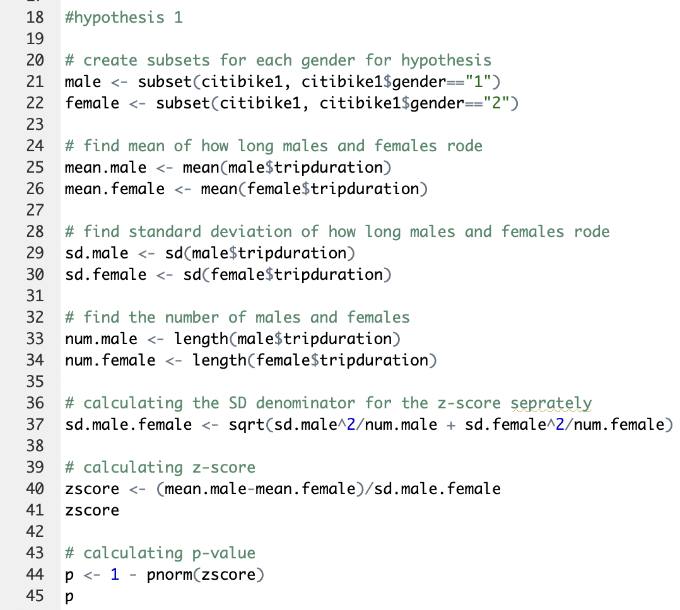

Slide 4
Hypothesis 2: Subscribers vs. Customers
For my second hypothesis test, I wanted to compare the Citibike user types and test to see if subscribers had a longer trip duration than customers during May 2020.
Null Hypothesis: Subscribers and customers had equivalent trip durations.
Alternate Hypothesis: Subscribers had a longer trip duration than customers.
Results:
z-score = -8.464466
p-value = 1
Since the calculated p-value is greater than a significance level of 0.05, we will accept the null hypothesis that subscribers and customers had equivalent trip durations, so there is no correlation between user type and trip duration.

Slide 5
